Slide 1




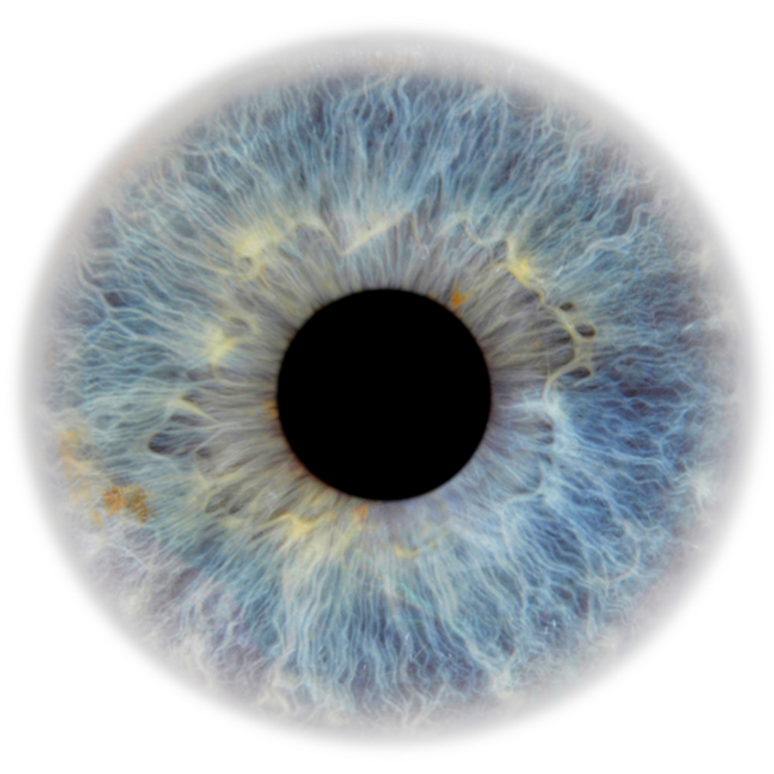
Computer Vision Methods for Fractographic Defect Detection in
Titanium and Aluminum Alloys
Presented by:
Wasim Shebalny
Shifaa Khatib

Slide 2



Motivation:
Additive Manufacturing (AM):
A modern fabrication technique that builds parts layer by layer directly from digital 3D models, enabling lightweight structures and complex geometries that are difficult or impossible to produce with traditional manufacturing.
-Key in aerospace, biomedical, automotive.
Challenges :
– Process-induced defects: porosity, roughness, residual stress
– Leads to fatigue cracks → initiation → propagation → fracture
- Manual Fractography is time consuming, where experts are required to examine the fracture surfaces.

Slide 3
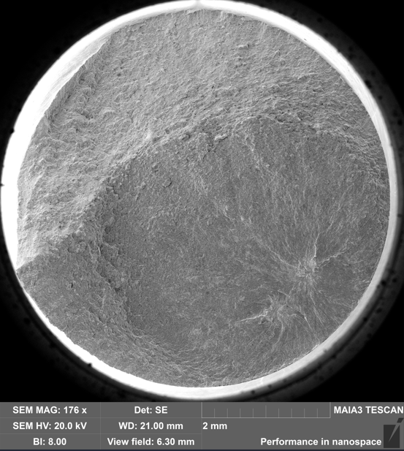

Fatigue Crack Propagation:
Cracks initiate at defects or surface irregularities.
They grow progressively Propagation continues until final fracture occurs.

Slide 4

our contribution:
Develop a fully automated Computer Vision pipeline for analyzing SEM images.
Detect, segment, and measure fatigue-induced cracks in titanium & aluminum alloys.
Replace manual fractographic inspection with a faster, objective, and reproducible solution.
Provide two main outputs:
Visual results → Heatmaps, contours, crack phases
Quantitative reports → Areas, statistics and data.

Slide 5
Dataset:
The dataset consists of high-resolution SEM images of fracture surfaces.
Contains specimens from additively manufactured titanium and aluminum alloys.
Divided into:
01
SLM Ti-6Al-4V → Produced using Selective Laser Melting.
EBM Ti-6Al-4V → Produced using Electron Beam Melting.
02

Slide 6

Proposed Approach & Workflow:
01
Preprocessing & Inner-shape extraction
02
Heatmap generation
03
Crack zone detection
04
Multi-phase contour extraction
05
Quantitative analysis

Slide 7
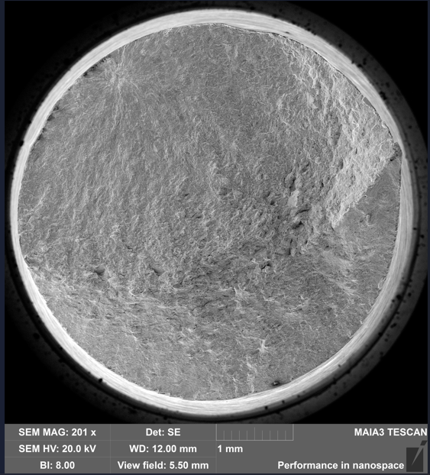
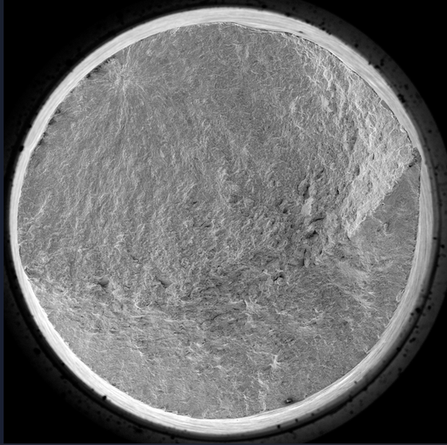
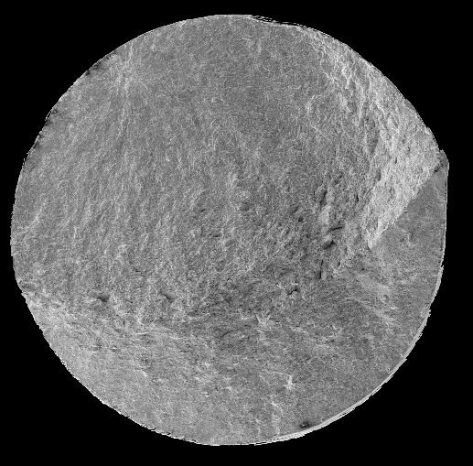

Preprocessing & Inner-Shape Extraction
Convert SEM images from TIFF → PNG.
Crop and normalize images into square format.
Use CLAHE, Gaussian smoothing, and Canny edge detection.
Generate binary masks and isolate the specimen.
“This ensures we focus only on the relevant fracture area”.

Slide 8
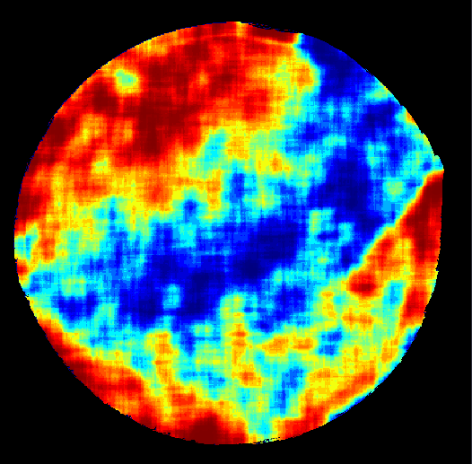
Heatmap Generation:
Convert to grayscale → smooth → detect gradients.
Use Sobel operator to highlight structural transitions.
Apply sliding-window averaging + histogram equalization.
Generate color heatmaps using JET colormap.
this is Enhance visibility of cracks and microstructural changes.”

Slide 9
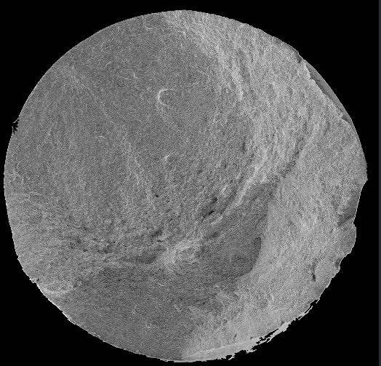
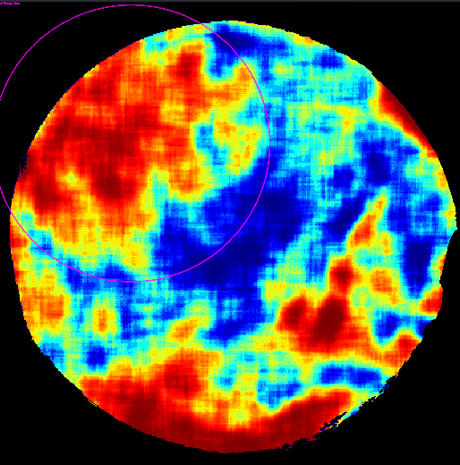
Crack Zone Detection:
Goal: Automatically locate the primary crack region.
Convert heatmaps to HSV color space for robust segmentation.
Use color thresholds to detect high-stress regions (red/orange areas).
Apply centroid-inclusion logic to ensure detected cracks are inside high-stress zones.

Slide 10
Multi-Phase Contour Extraction:
Goal: Separate and analyze five crack-growth phases based on heatmap colors:
Dark Red → Crack initiation
Red → Early propagation
Yellow → Intermediate fatigue growth
Cyan → Advanced propagation
Blue → Final failure
Fit contours with convex hulls, splines, or ellipses depending on phase complexity.
“This step captures the entire fracture history from initiation to failure.”

Slide 11
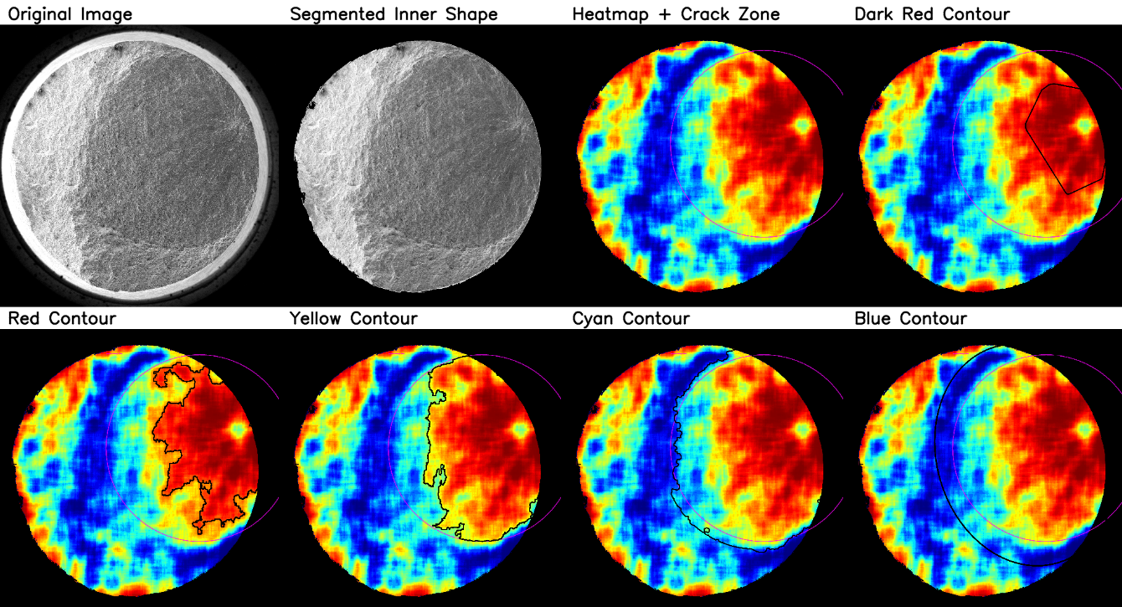

Slide 12
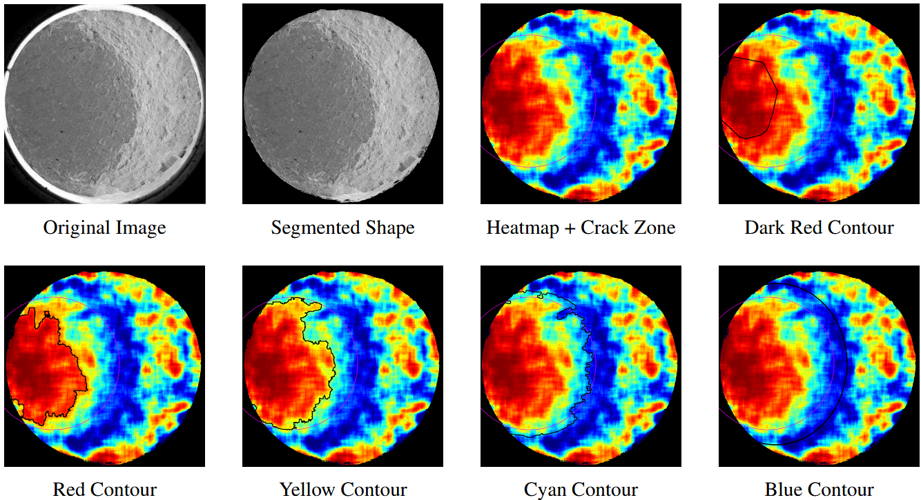

Slide 13
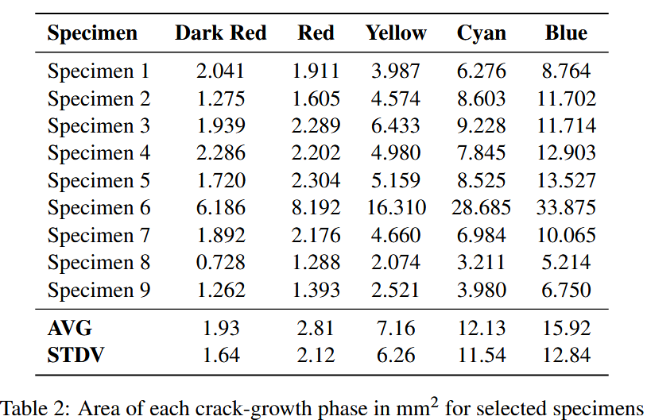
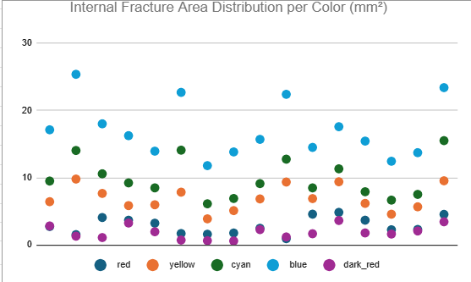
Quantitative Analysis:
Goal: Convert visual crack data into numerical measurements.
Calibrate using pixel-to-micrometer scaling:
1 pixel ≈ 1.34 μm.
Compute crack area for each phase → output in pixels & μm².
Save results into structured CSV files with per-specimen statistics.
Enables comparisons, reproducibility, and statistical modeling.

Slide 14

Conclusion:
In this project, we developed a fully automated computer vision framework that analyzes SEM images of additively manufactured alloys. It detects, segments, and quantifies cracks across different growth phases using heatmap-based analysis. The pipeline generates both visual and numerical results, ensuring accuracy, consistency, and reproducibility.

Slide 15
Future Work:
Integrate deep learning
Use models like U-Net and Mask R-CNN to improve segmentation accuracy.
3D fracture analysis
Extend the framework to study surface roughness & crack curvature in 3D.
Real-time monitoring
Adapt the pipeline for in-situ defect detection during additive manufacturing.
Benchmark datasets
Build large, standardized datasets for research & industrial use.

Slide 16
Thank You!

